Slide 1

SOFTWARE TECHNOLOGY 4483
KAEL MORDIKE | U3260796

Slide 2


Data SET
The Data set that I have chosen for this project is a data set of 525 bird species. 84635 training images, 2625 test images(5 images per species) and 2625 validation images(5 images per species. This is a very high-quality dataset where there is only one bird in each image and the bird typically takes up at least 50% of the pixels in the image. This data set consisted of 89886 rows of data.

Slide 3

Exploratory Data Analysis
I wrote a script to determine the background color of a set of test images and print the count of each background type found in the images. The script first imports the necessary libraries (os, cv2, numpy, and pandas) and defines the path to the directory containing the test images. It then loops over each species directory within the test directory, and for each species, loops over the five images numbered 1 to 5, adding the species name and image file path to a Pandas DataFrame.
I also wrote a separate script that answered the other initial questions that I had for my dataset. These being: 1. How many total images are in the dataset?
2. How many species are represented in the dataset?
3. What is the average number of images per species?
4. Which species has the most images in the dataset?

Slide 4
EDA Results and Charts
The printed results from my blocks of code, as well ass the generated graphs.

Slide 5
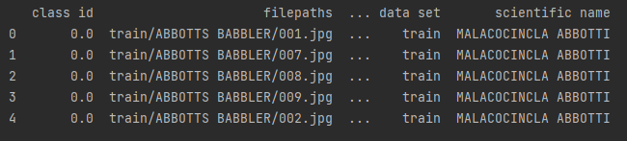
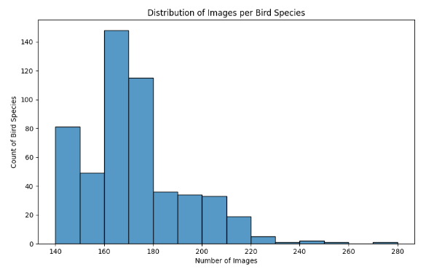
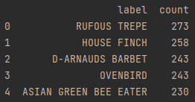
EDA RESULTS

Slide 6





Predictive Analytics on my Dataset.

Slide 7
Predictive Analytics
Logistic Regression
Random Forest Classifier
A logistic regression algorithm was trained on two datasets named “test” and “train” the accuracy of each of these was found and is as noted below:
“Test” Accuracy: 0.0
“Train” Accuracy: 0.01441484019613635
A Random Forest Classifier algorithm was trained on two datasets named “test” and “train” the accuracy of each of these was found and is as noted below:
“Test” Accuracy: 0.011428571428571429
“Train” Accuracy: 0.0618538429727654

Slide 8
GUI Implementation
The GUI allows users to interact with the trained model and classify new images of birds with a degree of accuracy dependent on the training duration.

Slide 9



Summary
During this project, I performed exploratory data analysis and visualization on my dataset using Pandas, NumPy, Matplotlib, and Seaborn. I produced five questions that I wanted to answer while exploring the dataset, and I used basic visualizations to help answer those questions.
I also performed classification using Scikit-learn to detect and predict different classes in the dataset. I trained several models and evaluated their performance to find the best one.
Finally, I implemented and deployed my application as a desktop GUI app using tkinter. The GUI allowed users to interact with the model and classify new images.

Slide 10




Thank you
KAEL MORDIKE | U3260796
U3260796@UNI.CANBERRA.EDU.AU

